Slide 1

An Autonomous Institution
DEPARTMENT OF COMPUTER SCIENCE AND ENGINEERING
PLACEMENT MINI PROJECT
TITLE - INVENTORY MANAGEMENT SYSTEM
TEAM MEMBERS
Nandhini - 113122UG03097
Gayathri - 113122UG03037
Salma - 113122UG03137
Gokul Raj- 113122UG03038
Lokchander-113122UGO3078

Slide 2


TABLE OF CONTENT
1.Abstratct 2.Introduction 3.Implementation
4.Architecture
5.Challenges & Prospects 6.Conclusion

Slide 3

ABSTRACT
The Inventory Management System is a comprehensive software solution designed to streamline the monitoring and management of inventory within a business dealing in electronic products.
The system offers a user-friendly interface that facilitates efficient tracking of products available for purchase by customers.
It ensures the seamless recording of customer details to enhance customer relationship management and improve service delivery.
This mini project is an effective tool for businesses to maintain an up-to-date inventory, manage customer and employee records, and ensure smooth interactions with suppliers.

Slide 4


INTRODUCTION
The Inventory Management System is developed as a mini-project to simplify the process of managing products, monitoring stock levels, and tracking customer, employee, and supplier information.
This project highlights the importance of integrating multiple functionalities into a single platform to optimize processes, reduce manual effort, and minimize errors.
Designed with user convenience in mind, the system provides an accessible and reliable solution for managing inventory, making it an indispensable tool for businesses focused on growth and efficiency.
The system facilitates the real-time tracking of product availability, ensuring customers have access to accurate information while making purchases

Slide 5


IMPLEMENTATION
Requirements Gathering: Understand the requirements of the inventory management system, such as types of products, quantity tracking, orders, etc.
User Interface Design: Implement the database schema based on the design created in the previous step using SQL or a database management tool.
Frontend Development: Implemented the user interface by using php language. Ensure it can interact with the backend to perform operations on the database.
Backend Development: Develop the backend logic to handle CRUD operations (Create, Read, Update, Delete) on the database.

Slide 6
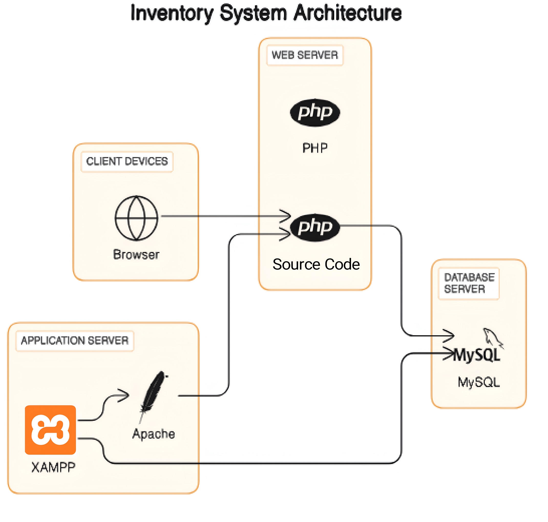
ARCHITECTURE

Slide 7

CHALLENGES AND PROSPECTS
Challenges in Inventory Management System:
Data Accuracy: Ensuring product, customer and transaction details are correct and updated.
Scalability: Handle more products, customers, and transactions as the business grows.
Data Security: Protecting sensitive information from potential threats or unauthorized access.
Prospects in Inventory Management System:
Improved Efficiency: Automates processes, saving time and reducing manual work.
Better Customer Satisfaction: Ensures product availability and a smoother shopping experience.
Cost Savings: Helps avoid unnecessary stock or shortages, reducing expenses.

Slide 8

CONCLUSION
In conclusion, the development and implementation of an Inventory Management System (IMS) represent a significant step towards enhancing the efficiency and effectiveness of inventory control within organizations. Through the utilization of modern technologies, including Php and Database Management Systems (DBMS), businesses can streamline their inventory processes, optimize resource utilization, and improve decision-making capabilities.

Slide 9
Thank you...

